Slide 1
Smart Inventory Web
Team Members:
Vyshnavi Srilaxmi Thannir Satya Phani Shyam Appasani Venkata Ajit Kumar Dokka

Slide 2



Team Members
Vyshnavi Srilaxmi Thannir Satya Phani Shyam Appasani Venkata Ajit Kumar Dokka

Slide 3
Outline :
Introduction
Scope
Functional Requirements
ER-Diagram
Tools and Technologies
Functional Prototypes
Database connectivity
Implementation
Venkata Ajit Kumar Dokka

Slide 4

Introduction
A smart inventory web design that helps Vendor(Admin) to sell his products on Amazon with the help of Dealers(Users) to easily buy and sell of the products.
Venkata Ajit Kumar Dokka

Slide 5
Scope
Help the dealers for amazon or any other online store for better way to maximize there profits by helping dealers to sell/buy more products through more suppliers without restrictions.
Venkata Ajit Kumar Dokka

Slide 6
Functional Requirements : Admin
Admin login
Password recovery
Post for an item/add item
Edit/delete the post
Accept/refuse user requests
Venkata Ajit Kumar Dokka

Slide 7
Functional Requirements : Admin
Able to remove/delete user
Send shipping labels
View user contact details
Platform for payment
Logout
Venkata Ajit Kumar Dokka

Slide 8
Functional Requirements : User
User Log in
Password Recovery
Sign up (User details page)
Viewing the item post
Request the user
Venkata Ajit Kumar Dokka

Slide 9
Functional Requirements : User
Edit/Cancel request
Payment history
Download shipping label
Logout
Venkata Ajit Kumar Dokka

Slide 10
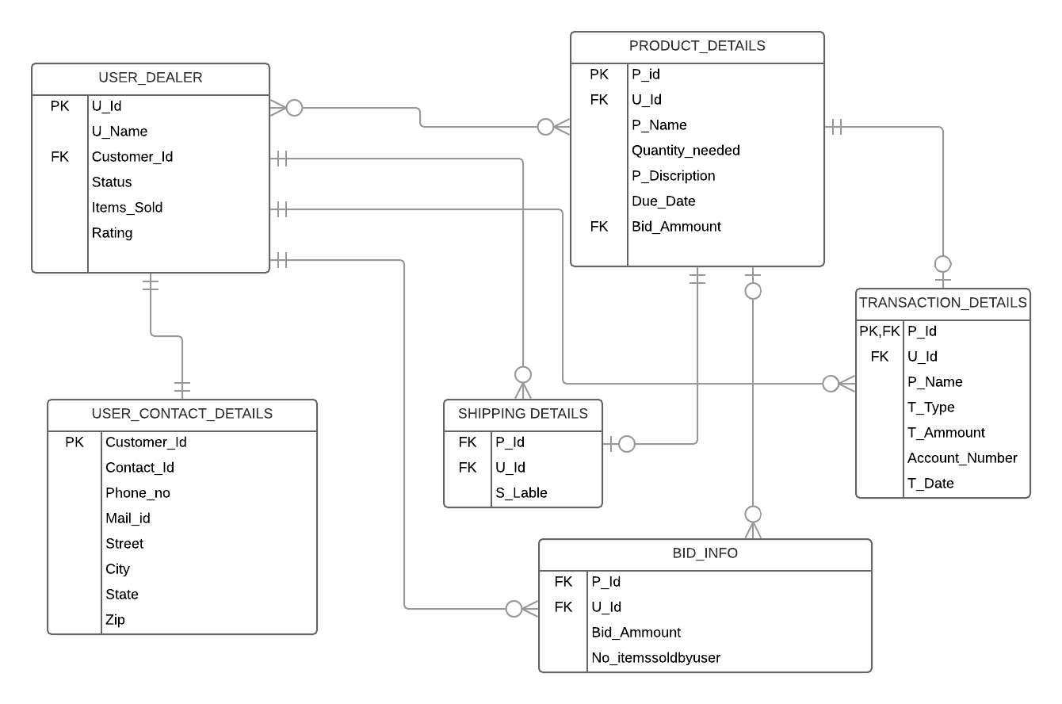
ER Diagram
Vyshnavi Srilaxmi Thannir

Slide 11

Technologies
MEAN Stack:
Database : MongoDB
Framework: Express
Front end: AngularJs
Server side : Node js
Vyshnavi Srilaxmi Thannir

Slide 12



Tools:
Robo Mongo
WebStorm
Github
Vyshnavi Srilaxmi Thannir

Slide 13
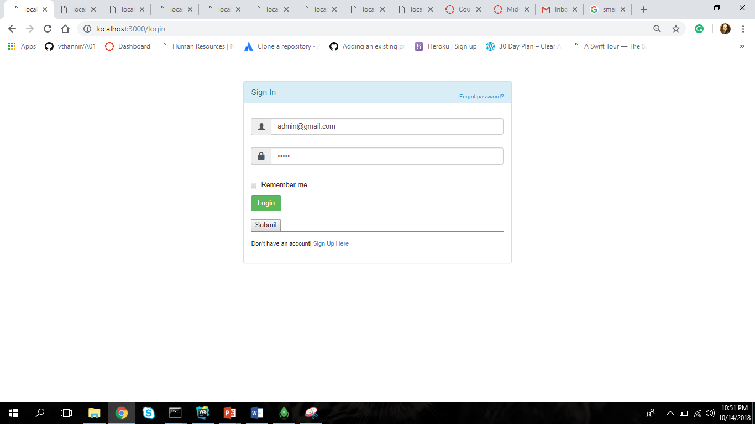
Functional Prototypes Admin Login
Vyshnavi Srilaxmi Thannir

Slide 14
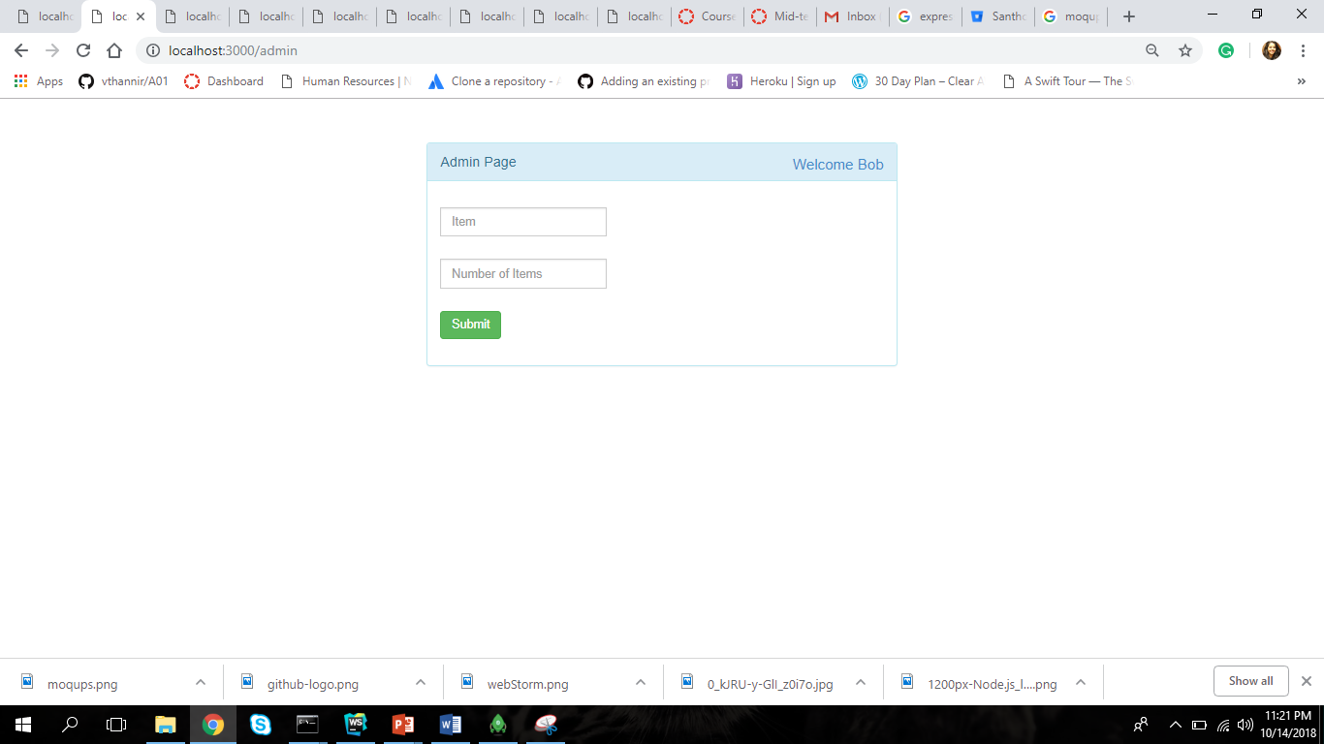
Functional Prototypes
Admin Page
Vyshnavi Srilaxmi Thannir

Slide 15
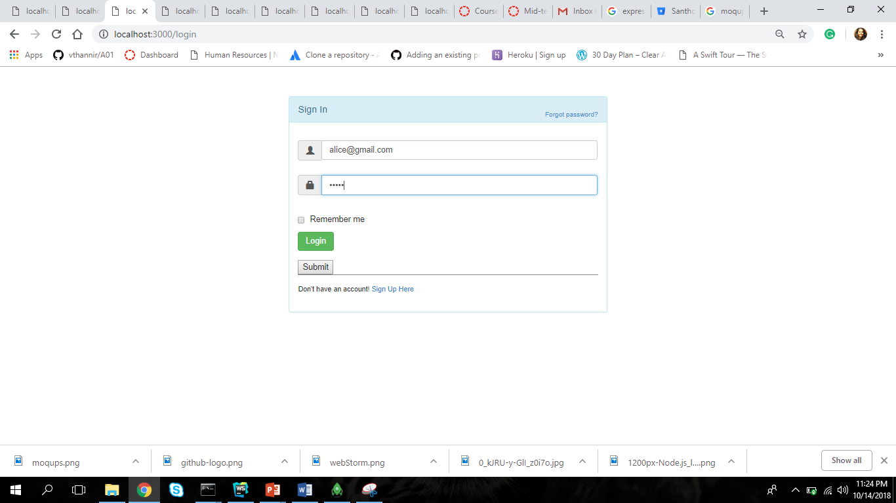
Functional Prototypes
User Sign In
Vyshnavi Srilaxmi Thannir

Slide 16
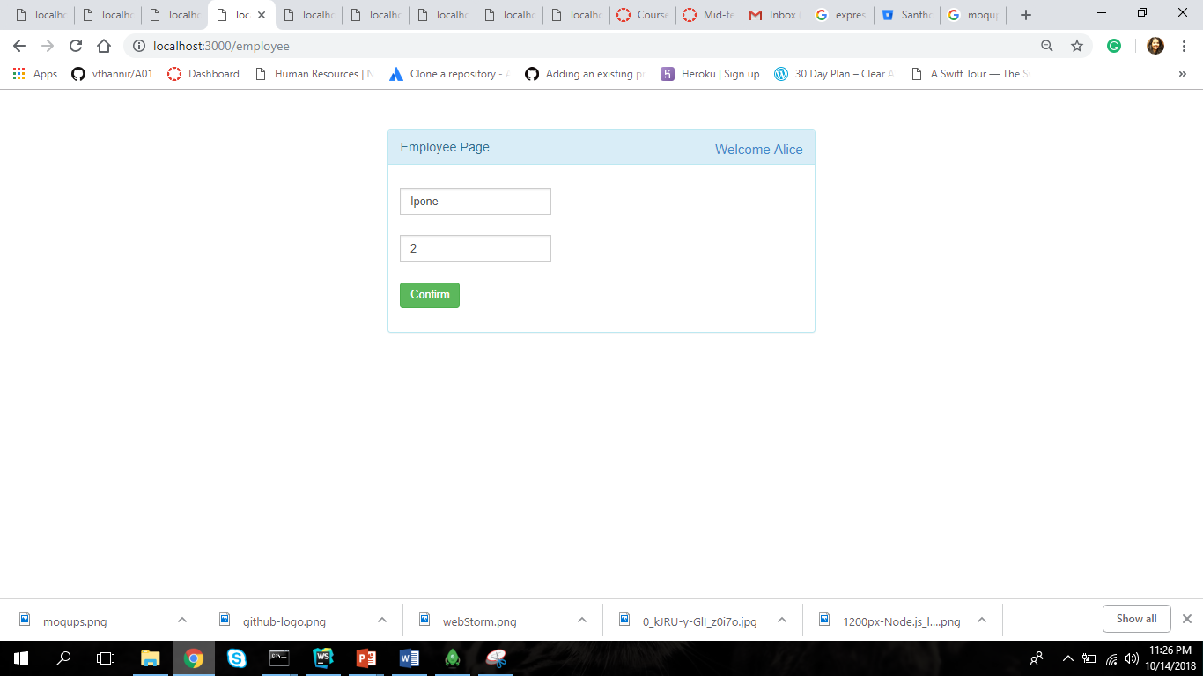
Functional Prototypes
User Request Page(1st user)

Slide 17
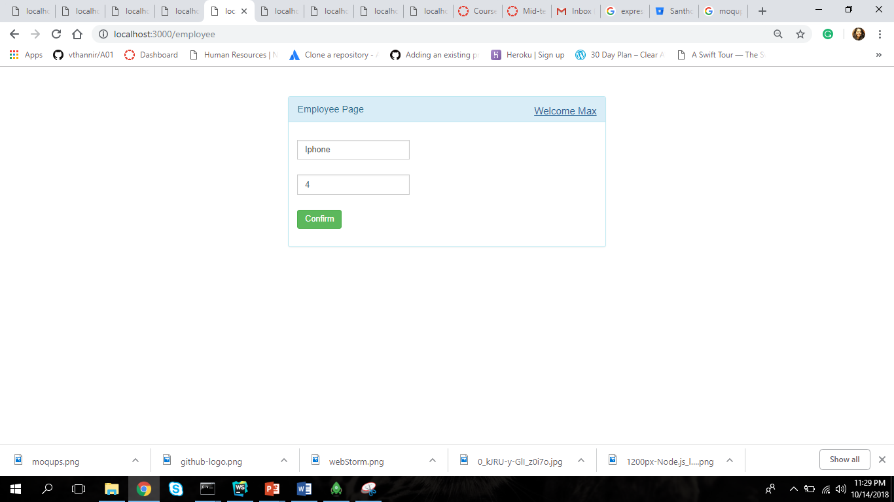
Functional Prototypes
User Request Page(2nd user)

Slide 18
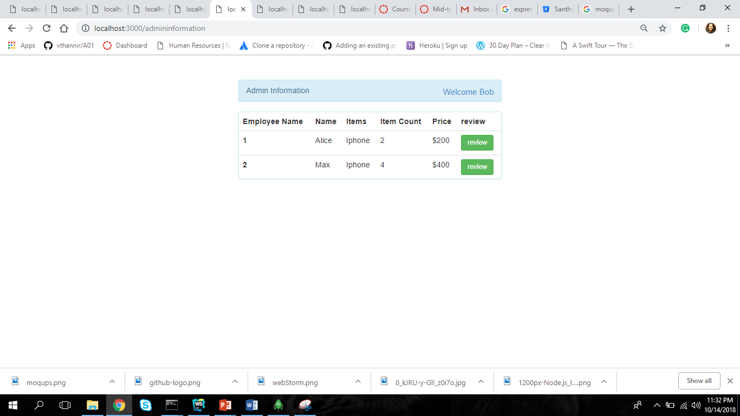
Functional Prototypes
Request Page at admin

Slide 19
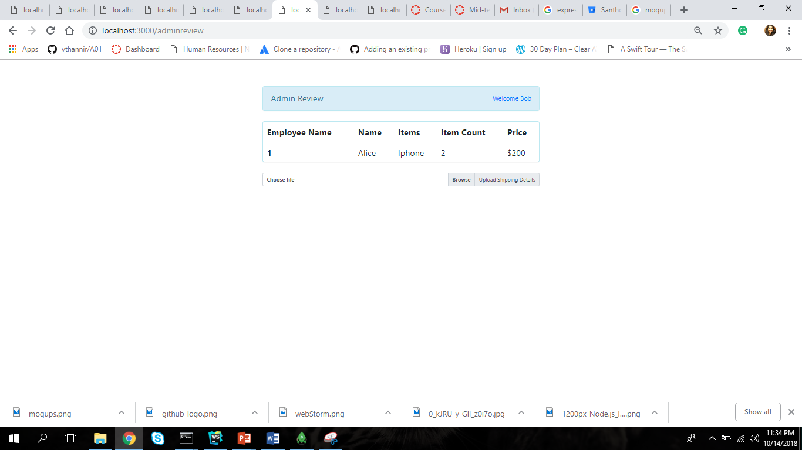
Functional Prototypes
Admin Review Page and sending shipping lable

Slide 20
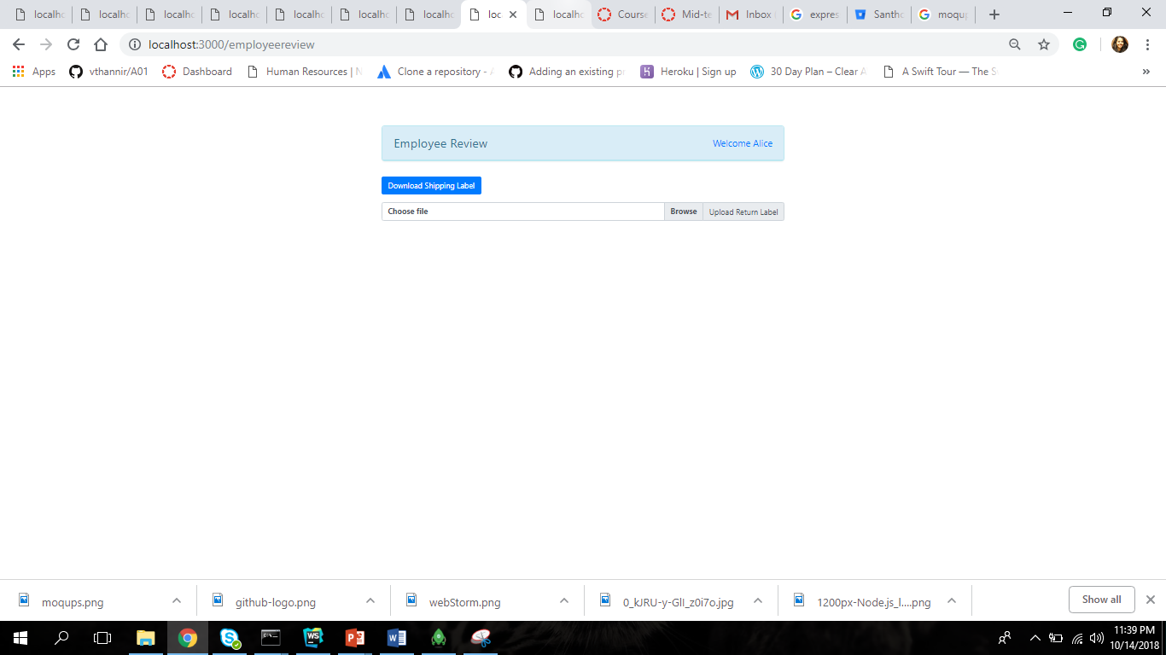
Functional Prototypes
User review and download shipping label and then uploads the shipping receipt into the system.

Slide 21
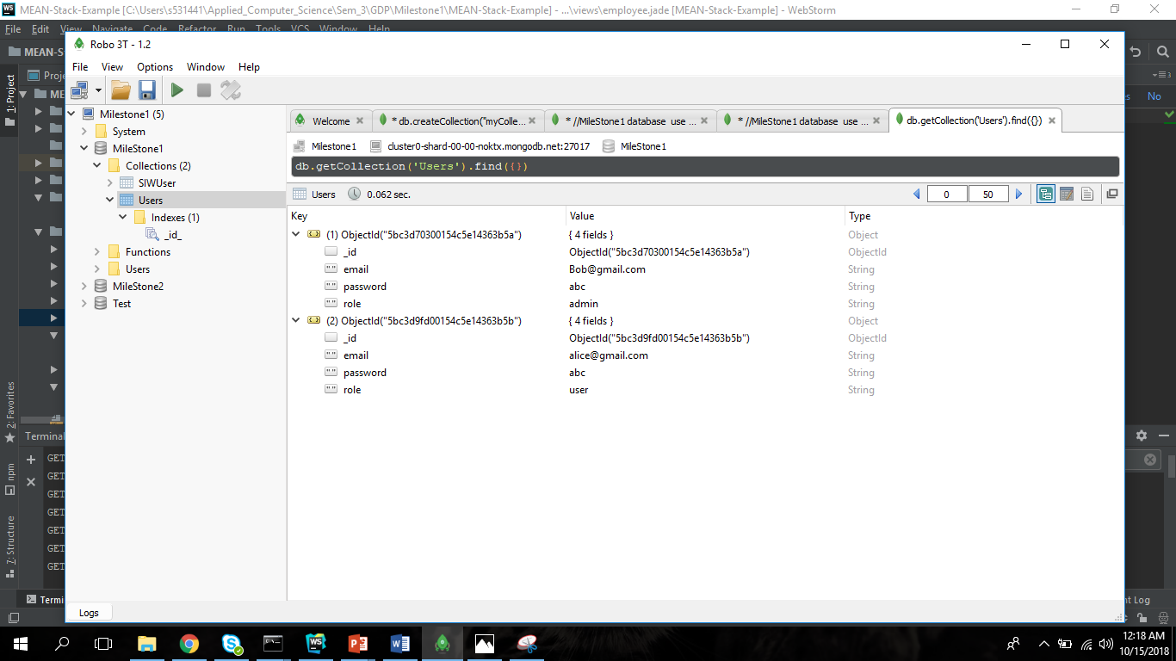
Database connectivity:

Slide 22
Conclusion:
Angular help in building dynamic web-pages
MongoDB is a noSQL language
MEAN stack one language for both server/client side

Slide 23
Questions ?

Slide 24
Thank you

